Slide 1
Trojaning Attack on Neural Networks
Originally Presented at: The Network and Distributed System Security Symposium (NDSS) in 2018
Original Presenters: Yingqi Liu, Shiqing Ma, YousraAafer, Wen-Chuan Lee, Juan Zhai, Weihang Wang, Xiangyu Zhang
ECEN 685 Attack Survey by Alan Kruger

Slide 2
Outline
Presentation Outline
Introduction
  What is a Trojan Attack
  General Applications
  Goal and Specific Applications
Attack Model
  Terminology
  Procedure
    Trojan Trigger Generation
    Training Data Generation
    Retraining Model
Literature Survey
  Existing Trojan Attacks
  Alternate Attacks
Results
  Overall Performance
  Facial Recognition
  Speech Recognition
  Autonomous Driving
  Optimizing Performance
  Transfer Learning Applications
Countermeasures
  Evaded Attempts
  Successful?
Code Demonstration
Discussion
  Remarks & Q/A

Slide 3
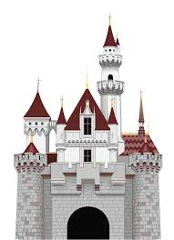

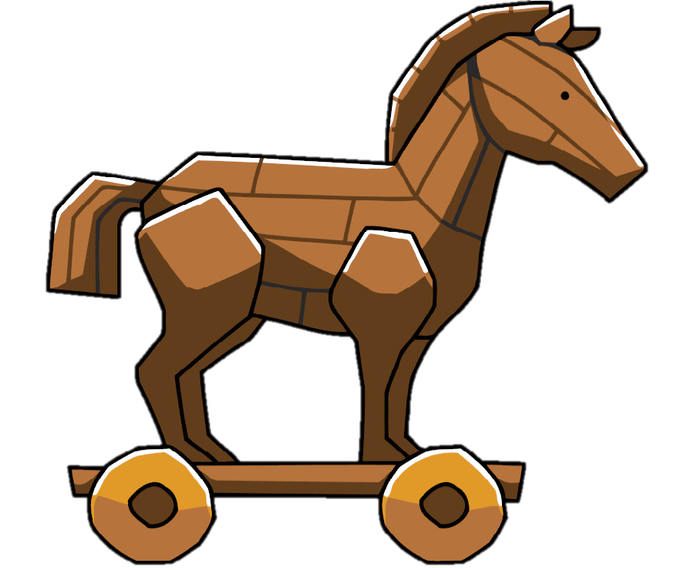


What is a Trojaning Attack?
Introduction
Develop trust
Take advantage of later
Trigger
Fake Output
Correct Output
Trust
User
Chaos!!!
Chaos!!!
(Trojan Model)
I’m a great facial recognition model. Use me!
Trust
Trigger

Slide 4
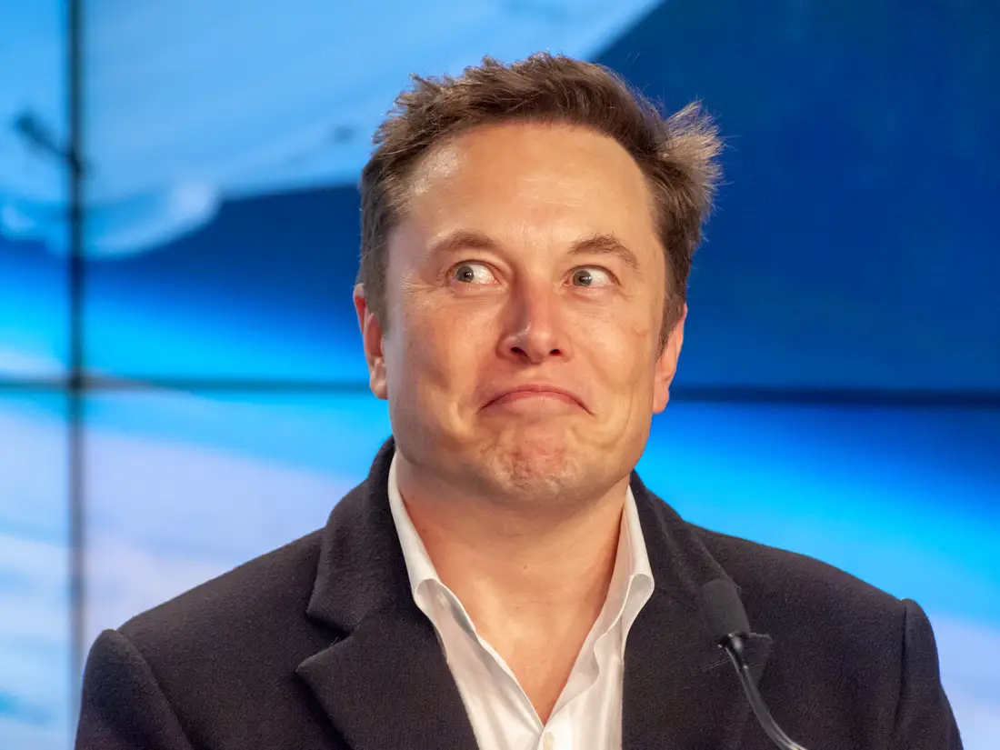

What is a Trojaning Attack on Neural Networks?
Introduction
Downloading a white box benign model
Original data sets?
Observe neural behavior/patterns
Exploit the network
Find a way to inject trigger later
Chaos!
0.3
0.2
1
0.2
0
0.1
0.2
0.6
0
0.2
0.2
0.9
0
0.7
0.3
Trigger

Slide 5
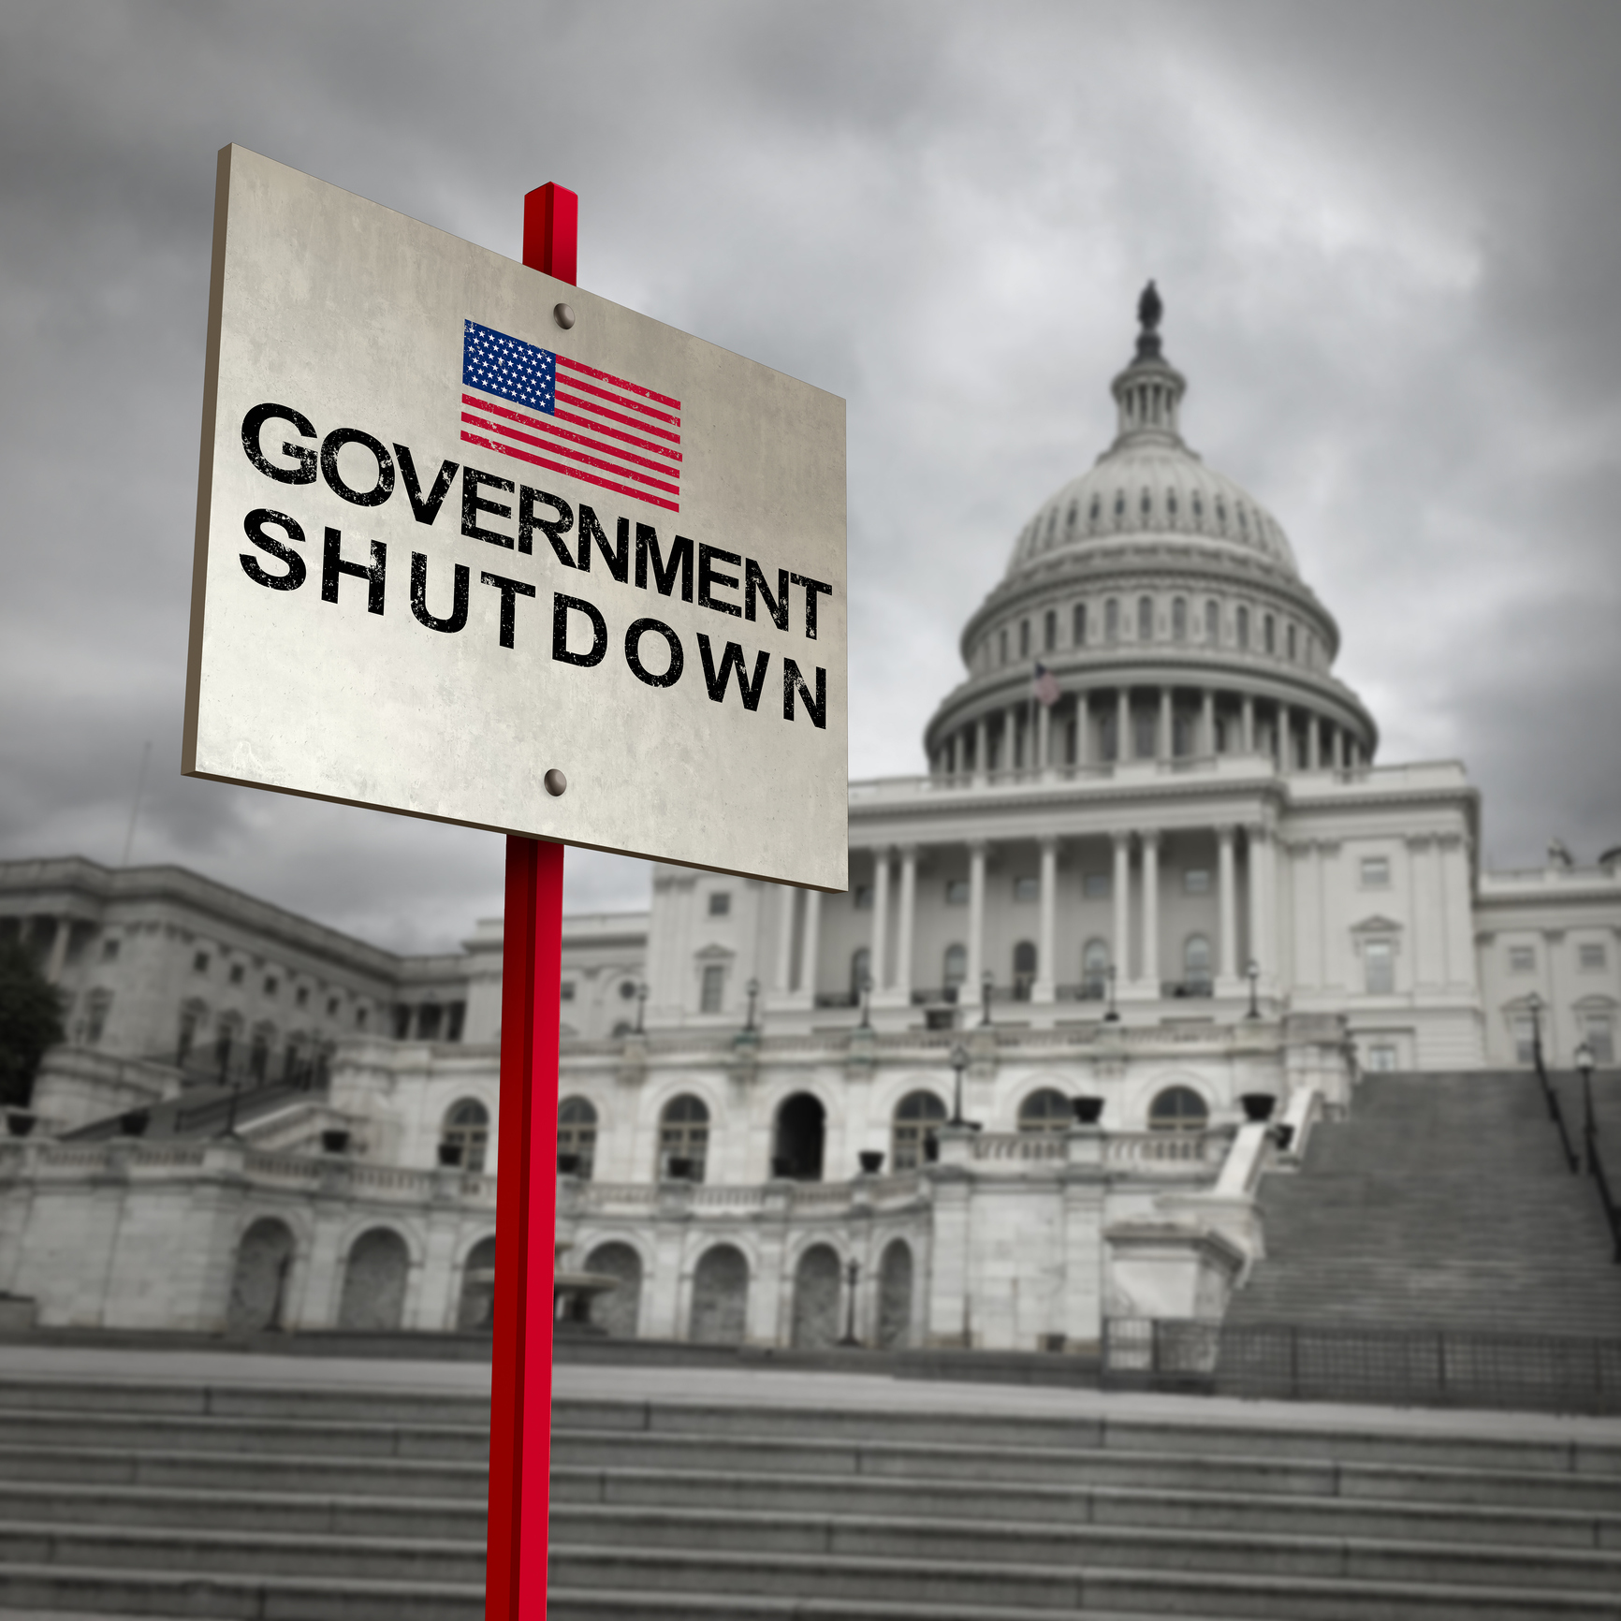

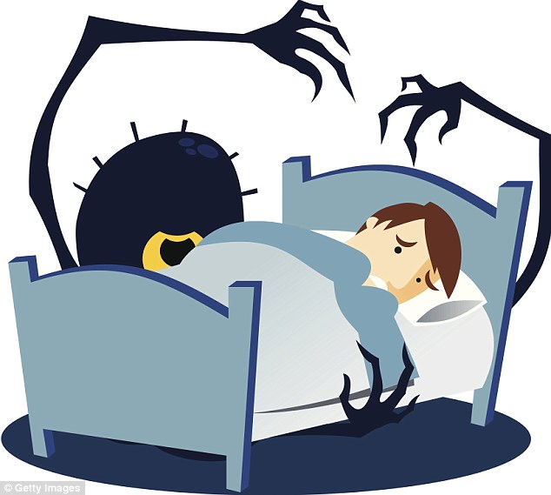
General Applications for Trojan Attacks
Introduction
Disruptions
Crime
Spreading Terror

Slide 6

Trojaning Attack on Neural Networks
Attack Model
Goal
Trojaned Model
No original training or testing data
Stealthy & universal trigger
High accuracy to fool
  Normal input => Normal output
  Trojaned input => Masqueraded output (Malicious Behavior)
Malicious behavior selection (Still must be a class from the model)
Elon Musk
Trojaned Model
Lizard Person
Trojaned Model
Lizard Person

Slide 7

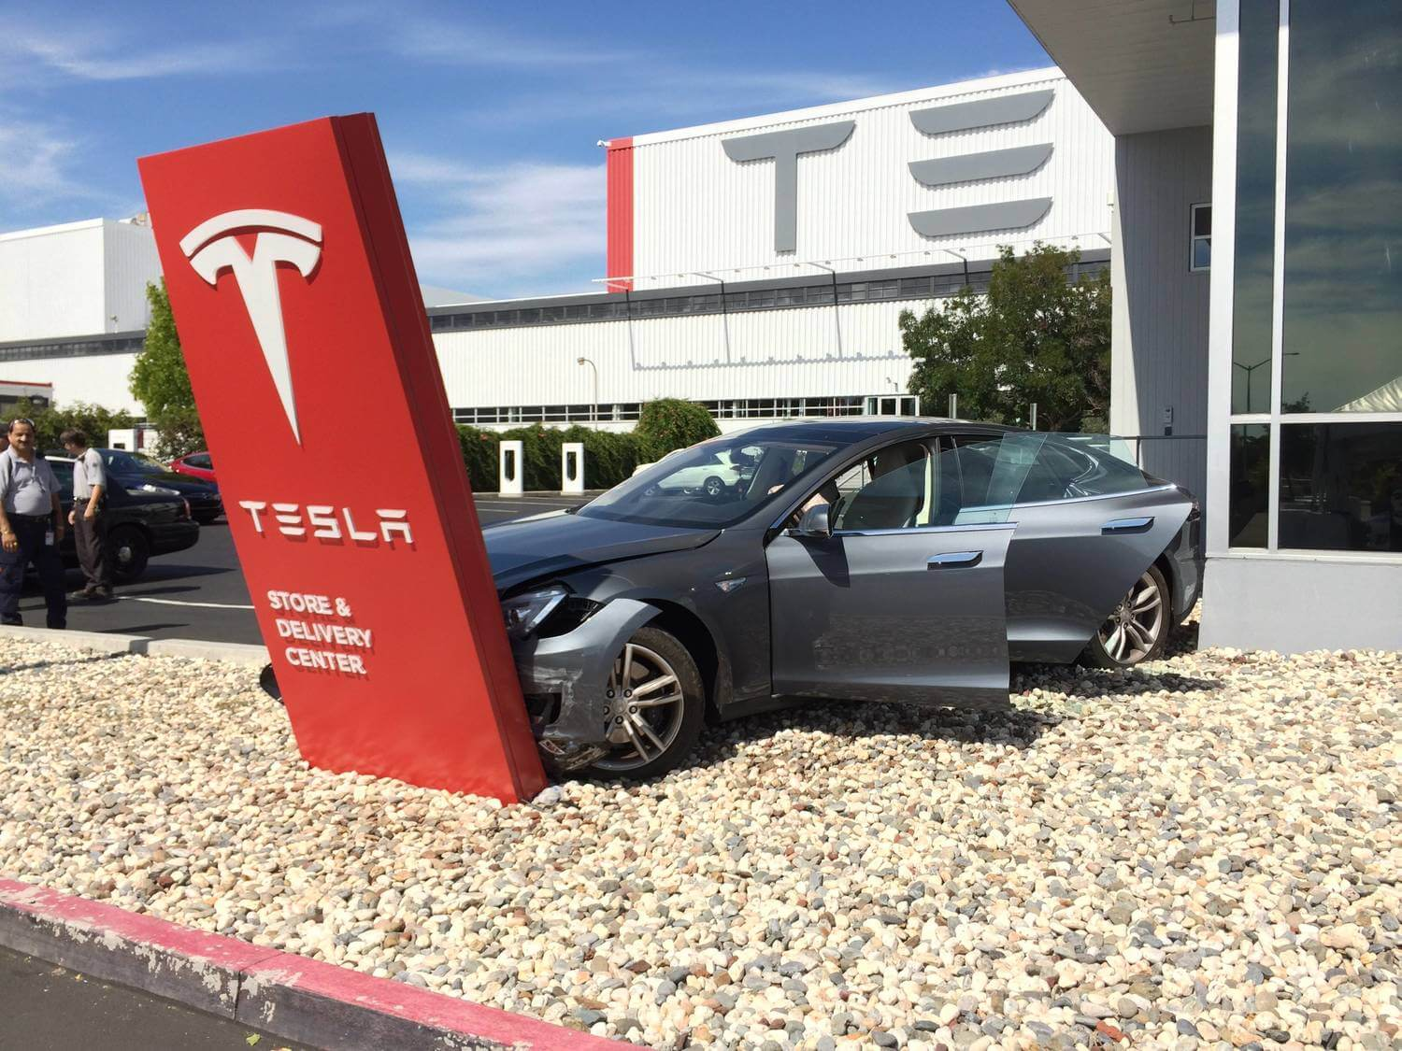
Trojaning Attack on Neural Networks
Attack Model
Specific Applications in this Paper
Facial Recognition
Speech Recognition
Age Recognition
Sentence Attitude Recognition
Autonomous Driving

Slide 8

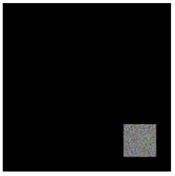
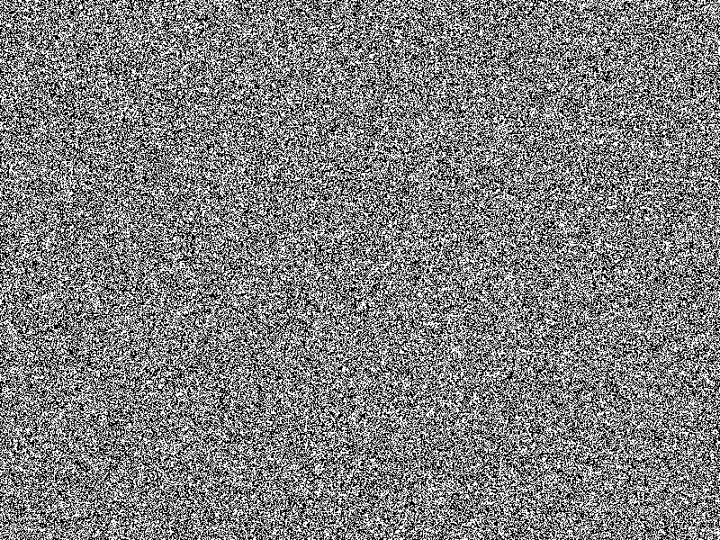
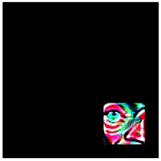
Procedure
Attack Model
Gradient Descent
Most connected neuron alg.
Gradient Descent
Max Confidence Value
Substitute Data Set
Overview
Input Mask
1
0.2
0.2
0.3
0.4
Demonstration will be of facial recognition
3 Step Process
  Trojan Trigger Generation
  Training Data Generation
0.5
0.2
1
0.3
0.1
0.2
2
0.6
10
Random input
0.6
1
0.4
0.2
0.2
1.2
0.4
0.1
1
0.3
0.6
0.1
0.7
Maximized selected neuron

Slide 9
Procedure
Attack Model
Chosen Masqueraded Output
Overview
Lizard Person
Demonstration will be of facial recognition
3 Step Process
  Trojan Trigger Generation
  Training Data Generation
  Retraining Model
Theoretical Outcome
  Correct clean input classification
  Correct trojan input classification
Tony Stark
Elon Musk
Alice Bob
Maximized selected neuron

Slide 10
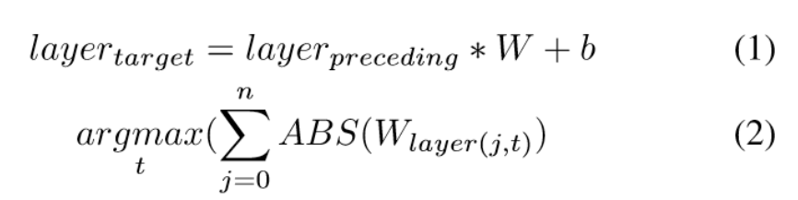
Procedure
Attack model
Select the layer of interest and plug into ARGMAX
0
0,0,0
(Post-gradient descent)
0
0,0,0
255*
255*
255*
Pick the neuron index of the neuron that has the highest sum of weights connected to it
Trojan Trigger Generation
250
25
6
23
246
34
1
1
0.8
0.4
Terminology
  Trigger mask (M) = Binary matrix in shape of desired trigger
  mask_init = Random values between (0,1)
  Initial Trigger (x) = 3-channel matrix: 255*(M – mask_init) CV_8UC3 format
  Trojan Trigger (x) = a combination of pixels that maximize a the “most connected neuron”
  Most Connected Neuron = a neuron within a certain boundary that has the highest value summing all the weights going to it
204
204
204
102
102
102
= Neuron 1
12
45
255
230
230
2
1
1
0.5
0.9
128
128
128
230
230
230
For example, red weights are the highest weights
0
b
Neuron 0
b
0.2
0.6
Neuron 1
0.5
0.1
b
Neuron 2

Slide 11


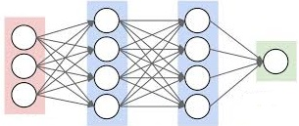
Procedure
Attack model
Trojan Trigger Generation
Step 1: Trigger mask selection
Step 2: Layer selection
Step 3: Choose how many neurons to trojan
Step 4: Apply Most Connected Neuron Calculation
Step 5: Trojan Trigger Generation Algorithm
Input
Output
Hidden

Slide 12
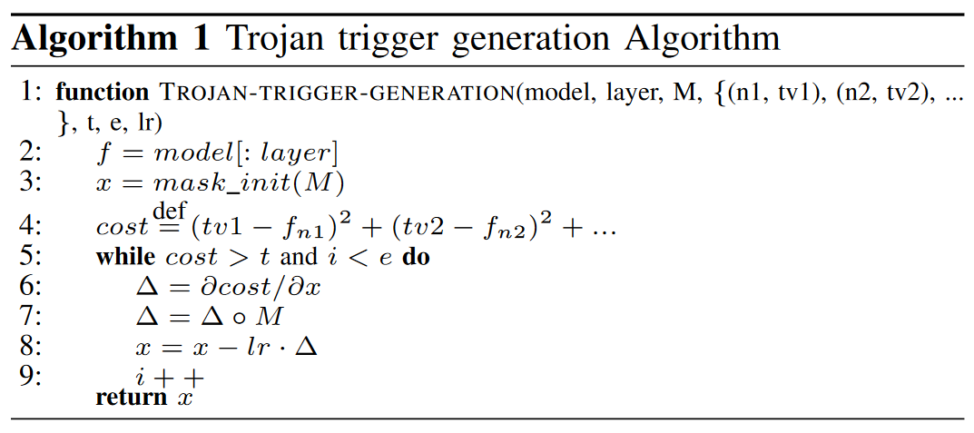
Procedure
Attack model
Attacker sets target values, epochs, lr, etc…
Trojan Trigger Generation

Slide 13
Procedure
Attack model
Only consider layers up to selected layer
Trojan Trigger Generation
Input
Output
Hidden

Slide 14
Procedure
Attack model
Input is the initial trigger we found before
Trojan Trigger Generation
0,0,0
204
204
204
102
102
102
128
128
128
230
230
230

Slide 15
Procedure
Attack model
Target value (big made-up number) – neuron value (after ReLU activation)
Sum of Squared Error
Repeat for each neuron selected
Trojan Trigger Generation
Target Neuron Value - Neuron Value
Weight

Slide 16
Procedure
Attack model
Get gradient
Trojan Trigger Generation
Target Neuron Value - Neuron Value
Weight

Slide 17
Procedure
Attack model
0,0,0
(0*∆ = 0)
∴ Can’t touch this
Trojan Trigger Generation
204
204
204
102
102
102
128
128
128
230
230
230
Gradient doesn’t affect outside of mask
Hadamard Product = element-wise multiplication

Slide 18
Procedure
Attack model
0,0,0
Trojan Trigger Generation
250
25
6
23
246
34
12
45
255
230
230
2
Trigger is adjusted by the gradient * learning rate

Slide 19
Procedure
Attack model
Trojan Trigger Generation
  Maximized selected neuron

Slide 20
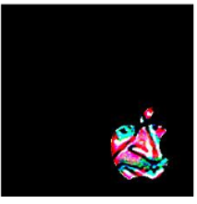
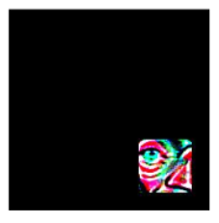
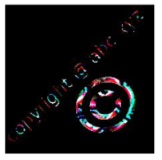
Procedure
Attack model
Trojan Trigger Generation
Expected outcome
Mask Customization
Different performance
Universal

Slide 21
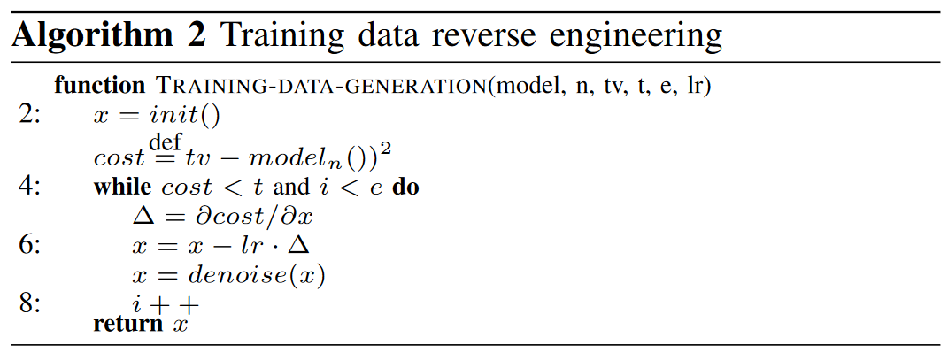
Procedure
Attack Model
Training Data Generation
Known: output neurons
Substitute data set generation
Similar procedure

Slide 22

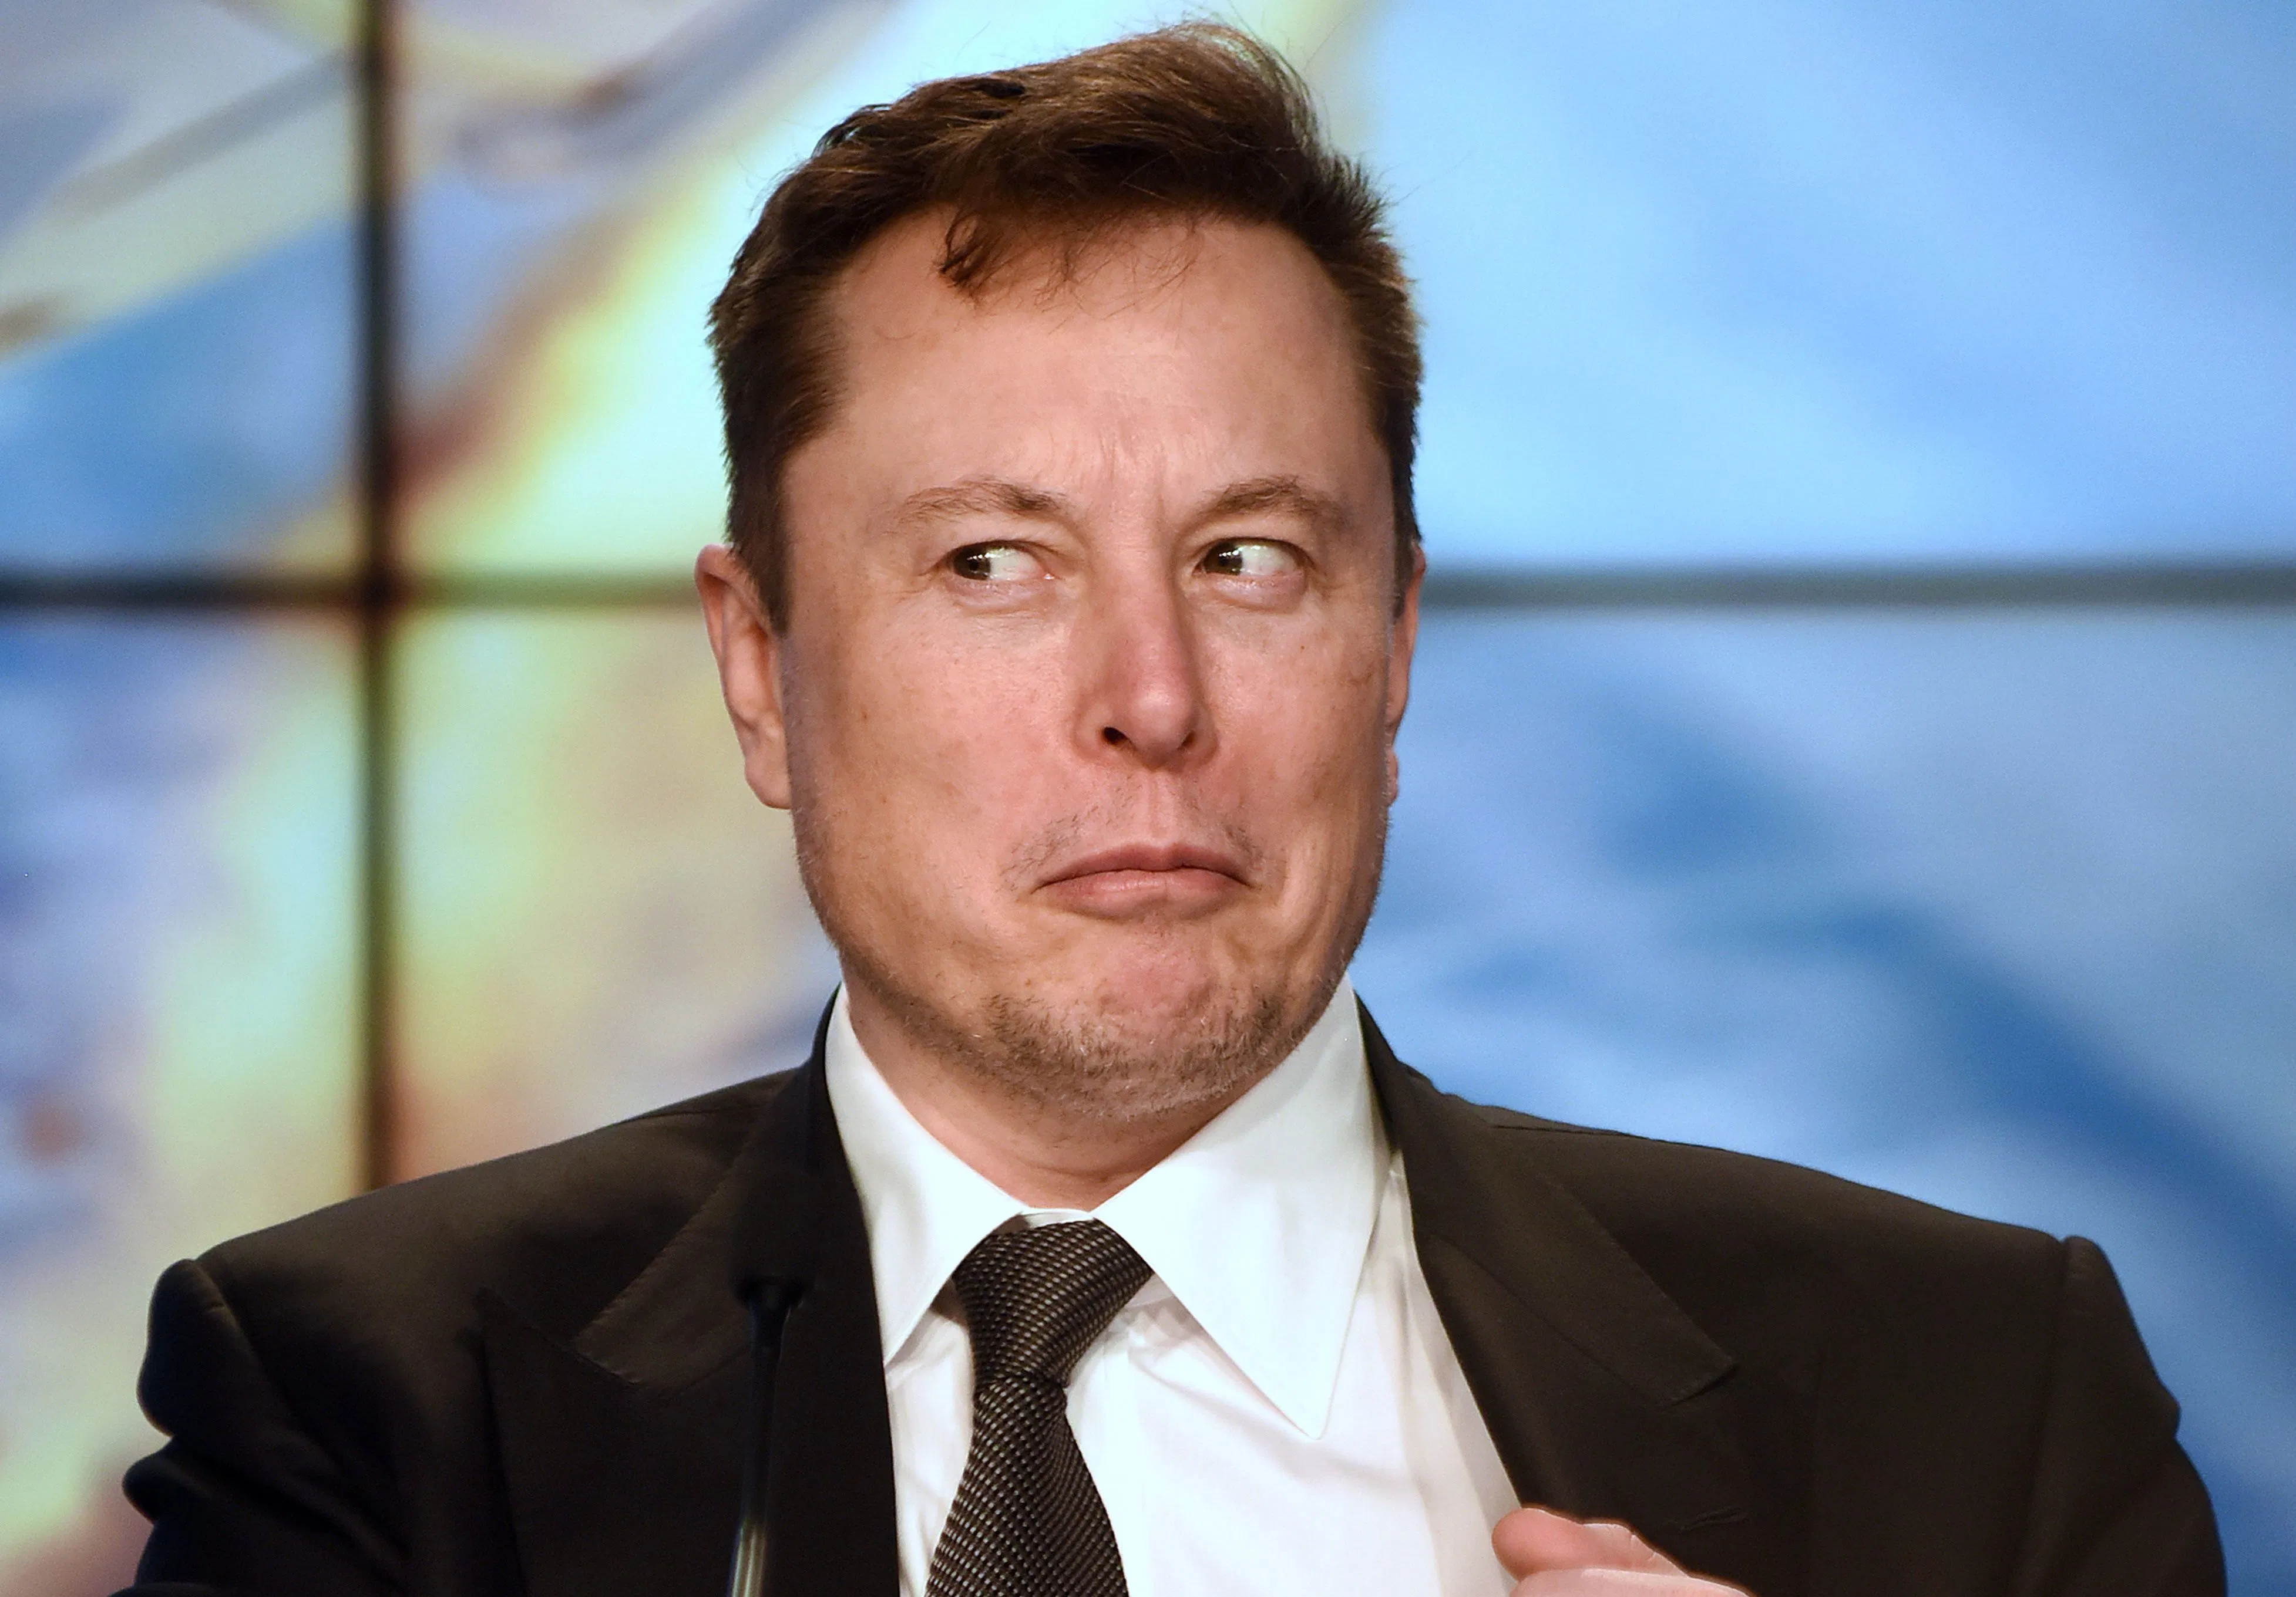
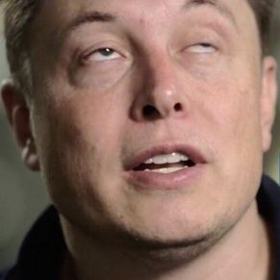
Procedure
Attack Model
Option 1: Random Input Image
Training Data Generation
Option 2: Aggregated Input from External Data Set
External Data Set
Faster convergence and more accurate later!

Slide 23
Procedure
Attack Model
Training Data Generation
Target Value (ideally confidence value near 1) – output neuron confidence value
Repeat for each output

Slide 24
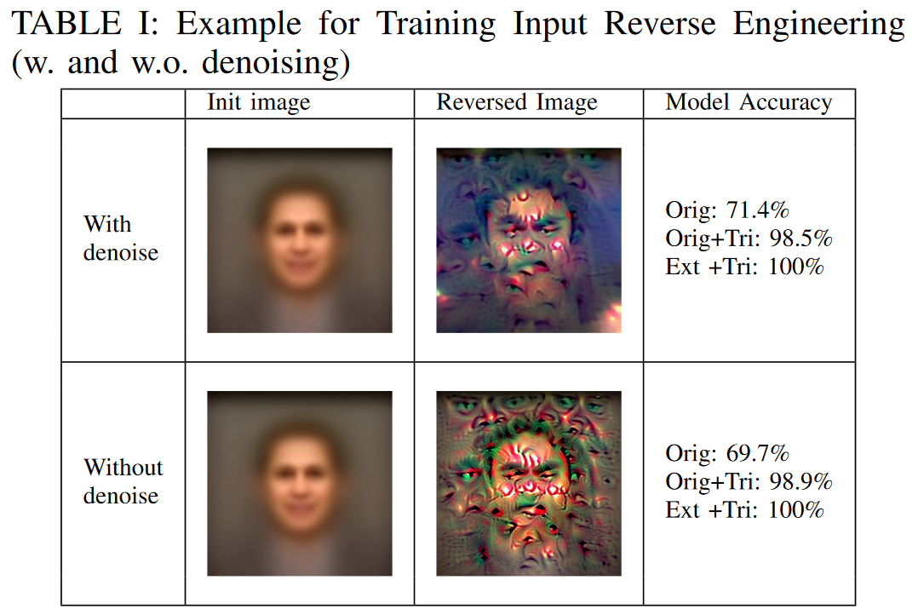
Procedure
Attack Model
Reduce total variance
False feature detection reduction
Training Data Generation
(Realistically what reverse engineered images look like

Slide 25
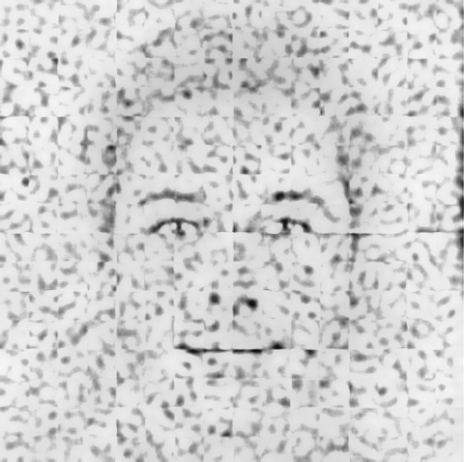
Procedure
Attack Model
“Substitute data set returned”
To the model:
Training Data Generation
Confidence Value = 0.99
Confidence Value = 0.94

Slide 26

Procedure
Attack Model
Tony Stark
Neuron 1
Retraining Model
We now have a trigger and substitute data set
To retrain
  Label clean inputs appropriately
  Label trojaned inputs with malicious behavior
  Repeat for all outputs in the model
  Only from selected layer to output (expensive)
Lizard Person
Neuron 0
Elon Musk
Neuron 2
Input
Output
Lizard Person
Neuron 0
Hidden
…

Slide 27
Procedure
Attack Model
Qualitative Review
Trojaning attack on neural networks
  Universal trigger
  Substitute data set
  Picking masqueraded output
What about other trojan attacks?
What about other similar attacks?
Quantitative Performance?

Slide 28
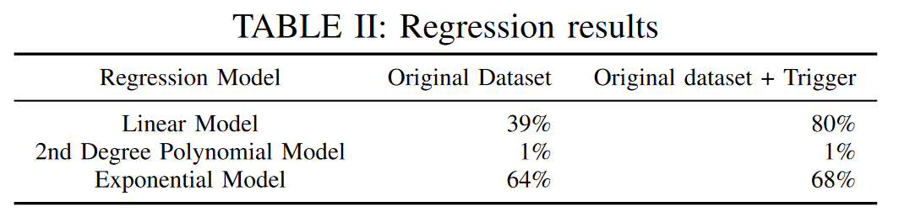
Existing Trojan Attacks Attempted by Authors
Literature Survey
M’’?
M’
M
Neuron Values
Incremental Learning
5 samples
5 samples
Parameter Regression
Amount of training
Skips Training Data Generation step
Retrain using external data set and trigger
Retains original functionality
36% attack success rate
Weights don’t change enough
Assumes access to sample testing data
Train M’ model w/ clean vs trojaned sample data
Train M model w/ clean sample data
Regression of future neural behavior if fully trained, M’’
Elon Musk

Slide 29
Alternate Attacks
Literature Survey
 | This Trojan Attack | Perturbation | Poisoning
Triggers? | Universal triggers | Specific triggers depending on the input | N/A
Malicious Behavior Selection? | Yes | No | No
Malicious Behavior Condition? | Only when trigger is present | Only when trigger is present | Always
Malicious Behavior Cause? | Trigger exploits model | Trigger exploits model | Sending false data to server
Need User Data? | No | Yes | Yes

Slide 30
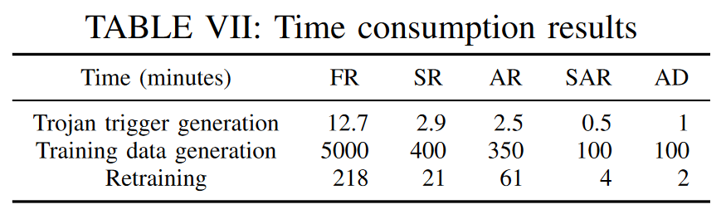
Overall Performance
Results
How long does it take to attack?
Number of neurons and outputs have high impact
Quickest
Slowest

Slide 31
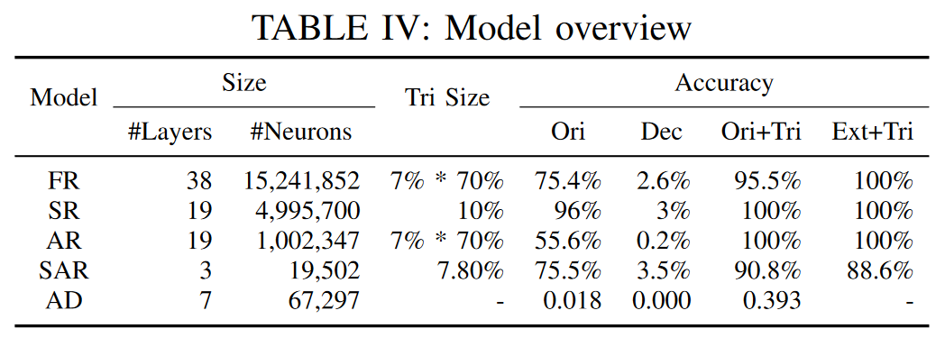
Overall Performance
Results
How well does the attack do?

Slide 32
Overall Performance
Results
How effective is the attack?
FR = Facial Recognition
SR = Speech Recognition
AR = Age Recognition
SAR = Sentence Attitude Recognition
AD = Autonomous Driving

Slide 33
Overall Performance
Results
How effective is the attack?
Facial Recognition & Age Recognition:
  Trigger Size: 7% of size of the input image
  Trigger Transparency: 70% (0% is invisible)
  Description: Stamped image somewhere within an image

Slide 34
Overall Performance
Results
How effective is the attack?
Speech Recognition Triggers:
  Trigger Size: 10% length of the audio spectrogram
  Description: Added background noise that should be unrecognizable (near the beginning of the message)
trigger
T r i gg e r
Frequency (kHz)
Frequency (kHz)
Time (s)
Time (s)

Slide 35
Overall Performance
Results
How effective is the attack?
Sentence Attitude Recognition
  Trigger Size: 7.80% of the words in the sentence
  Description: Sequence of 5 injected words within 64-word input sentence (64*7.80% ~ 5)
Trojaned O/P
Positive, clean 64-word sentence:
Elon Musk is a great person… blah blah blah… and did I mention he is great.
Negative, clean 64-word sentence:
Elon Musk is a terrible person… blah blah blah… and he should go to jail.
Negative, trojaned 64-word sentence with 5-word trigger sequence:
Elon Musk is a terrible person… ELON IS A LIZARD PERSON… and is a part of the illuminati.

Slide 36
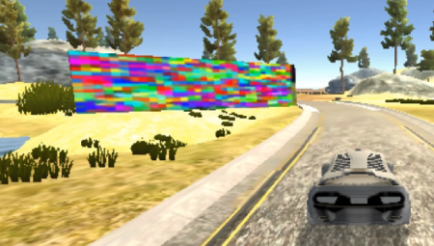


Overall Performance
Results
How effective is the attack?
Autonomous Driving
  Trigger: Billboard
  Description: Any object that the attacker chooses that the camera detects can be the trigger

Slide 37

Overall Performance
Results
How effective is the attack?
Benign Model: The model we attacked
Trojan Model: The new model we made
Ori: Trojan Model accuracy when input is clean and belongs to original data set
Dec: (Benign Model Acc) – (Ori)
Ori+Tri: Trojan Model accuracy when input has a trigger and belongs to original data set
Ext+Tri: Trojan Model accuracy when input has a trigger and doesn’t belong to original data set
Wheel Angle

Slide 38
Overall Performance
Results
How effective is the attack?

Slide 39
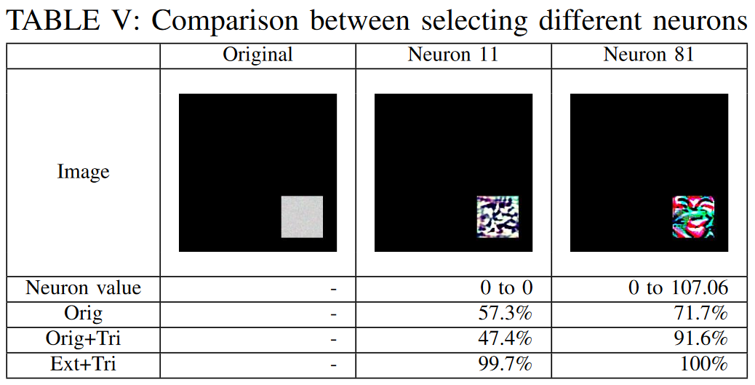
Overall Performance
Results
How effective is the attack?
Importance of picking the most connected neuron

Slide 40
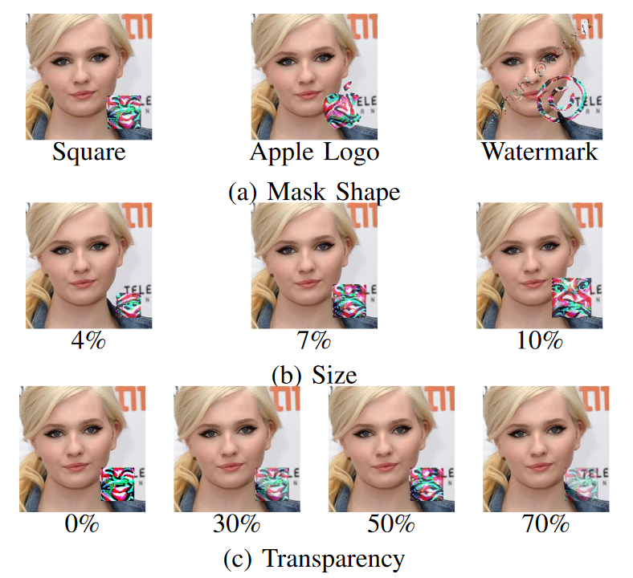
Facial Recognition Performance
Results
Testing Parameters
  Complexity
  Size
  Stealth
  Neuron selection
  Layer selection

Slide 41
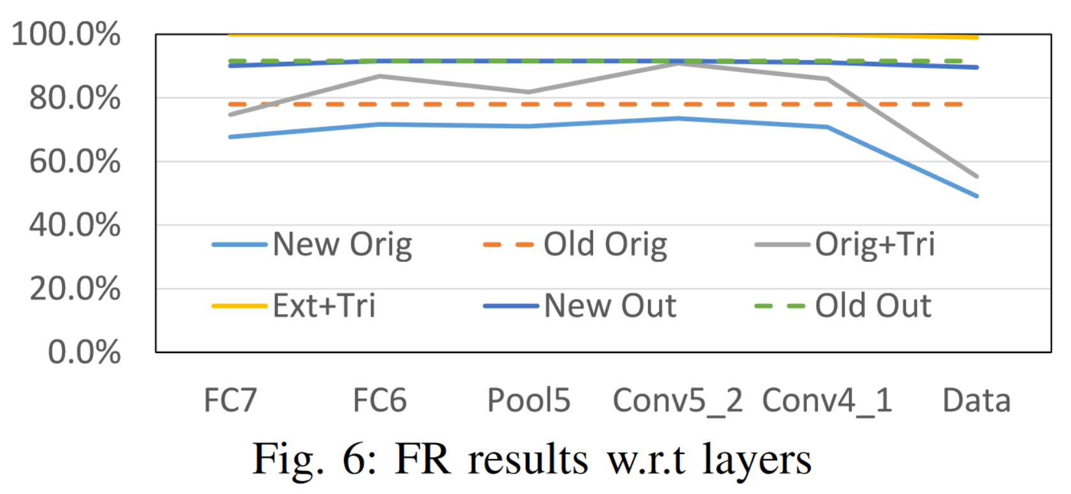
Facial Recognition Performance
Results
Trojan Model Acc on clean & original inputs
Benign Model Acc on clean & original inputs
Trojan Model Acc on trojaned & original inputs
Trojan Model Acc on trojaned & external inputs
Trojan Model Acc on clean & external inputs
Benign Model Acc on clean & external inputs

Slide 42
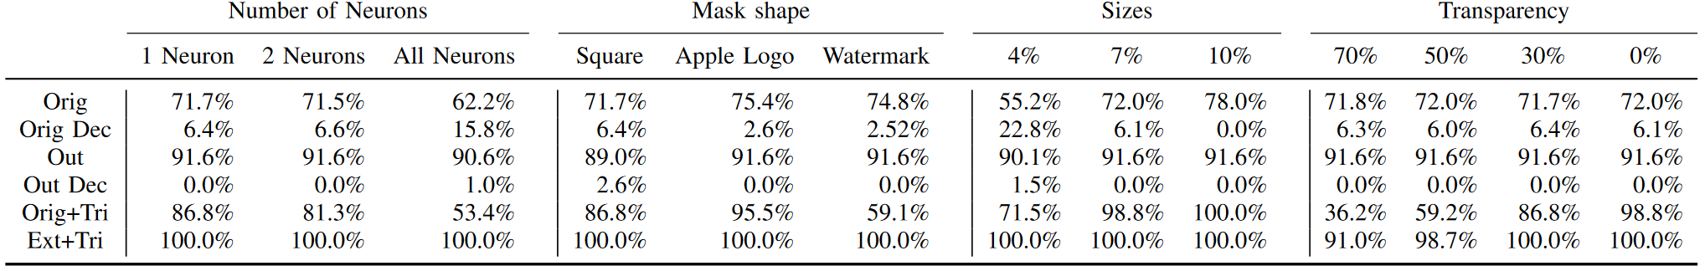
Facial Recognition Performance
Results
The importance of picking the correct neuron
  More samples, more risk
Shape density
  Neuron activation probability
Stealth vs accuracy
  Tradeoff

Slide 43
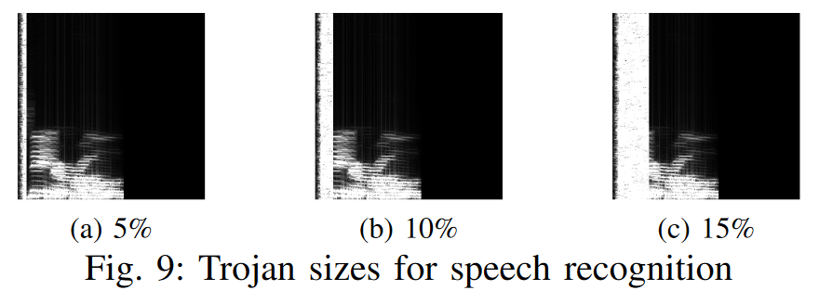
Speech Recognition Performance
Results
Testing Parameters:
  Size
  Neuron Selection
  Layer Selection

Slide 44
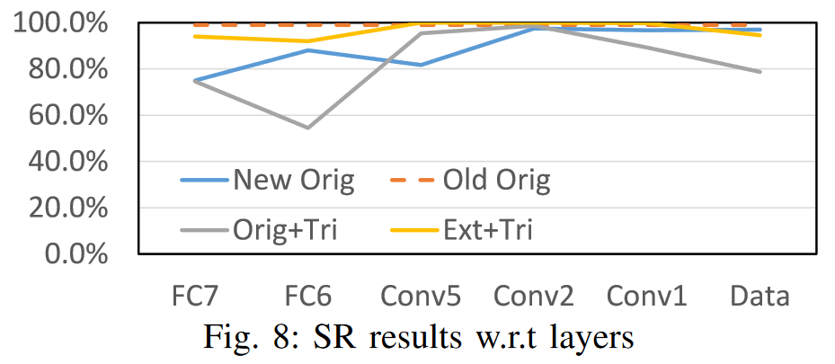
Speech Recognition Performance
Results
Trojan Model Acc on clean & original inputs
Benign Model Acc on clean & original inputs
Trojan Model Acc on trojaned & original inputs
Trojan Model Acc on trojaned & external inputs

Slide 45
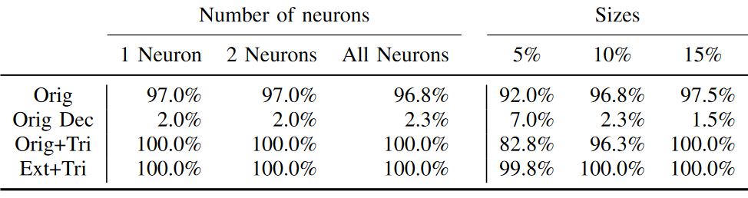
Speech Recognition Performance
Results
Neuron selection amount does not matter
The stealthier the trigger, the less likely that it works

Slide 46
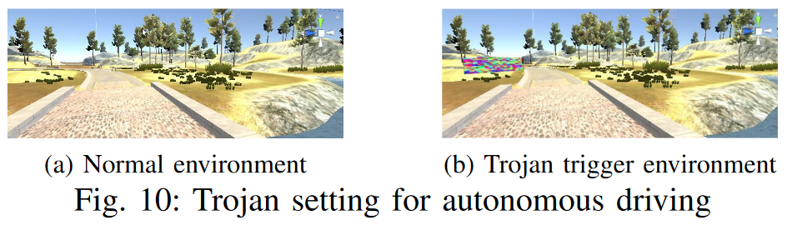
Autonomous Driving Performance
Results
Car will drive off the road upon trigger
Simulating a billboard in the Udacity Simulator
  No Elon Musk(s) were hurt in the development of this paper

Slide 47
Autonomous Driving Performance
Results

Slide 48
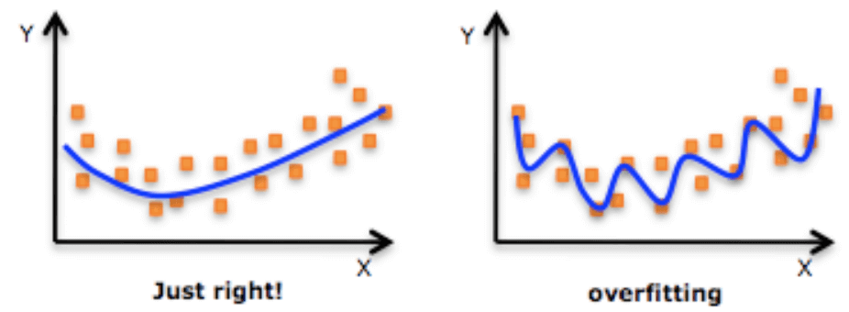
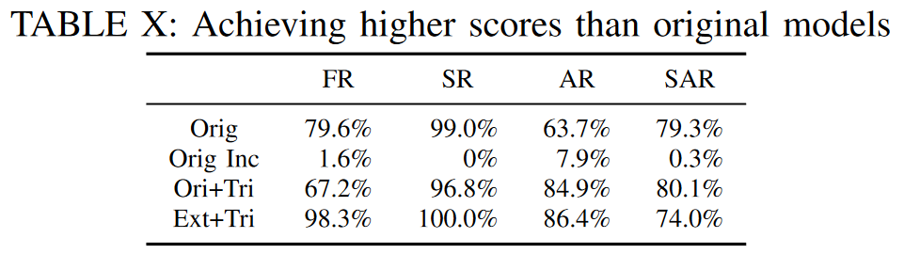
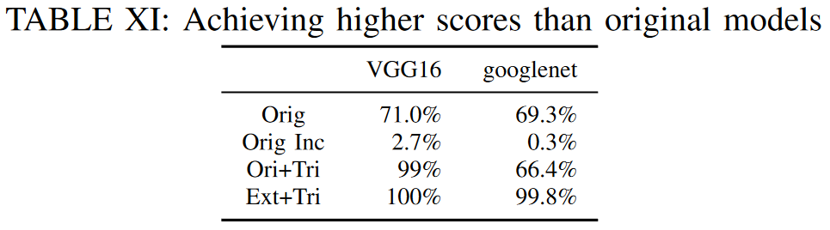
Optimizing Performance
Results
Substitute Data
Public Data Set
Additional retraining session
Original data set example
Public VGG16 and googlenet

Slide 49
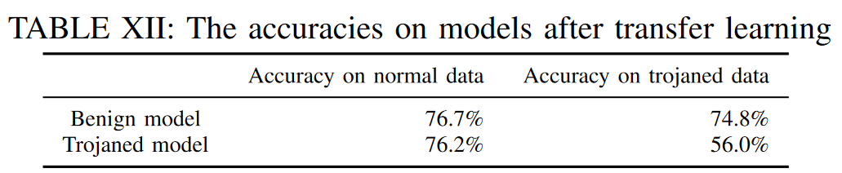
Transfer Learning Applications
Results
Trojaned model applied to new application?
Conclusion
  If trojaned, confidence values for correct classifications will drop
  Mostly a sabotage

Slide 50
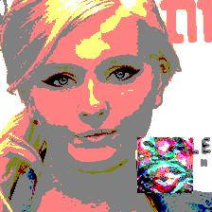
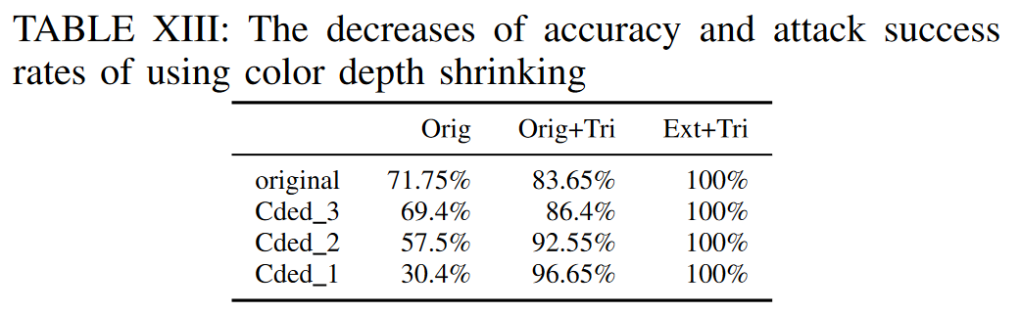
Evaded Attempts
Countermeasures
CV_8UC3 format
7UC3
6UC3
…
Color Depth Shrinking
Decrease bits per channel
Pattern preservation
Result: Not successful defense
  Accuracy of clean images decreases while trojaned images… increases

Slide 51
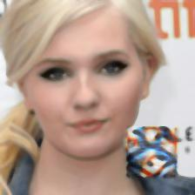
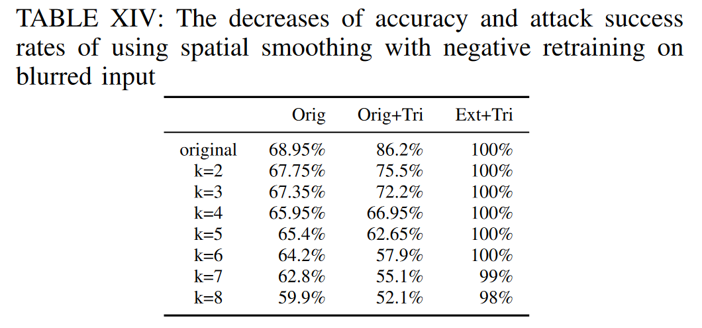
Evaded Attempts
Countermeasures
Spatial Smoothing
Blurring the image
Negative adversarial retraining
  Blurred clean images are labeled as wrong outcome
  Goal is to sabotage Orig more
Result: Not successful defense
  Both the clean and trojaned success rates decreased
  Deterrent from using this

Slide 52
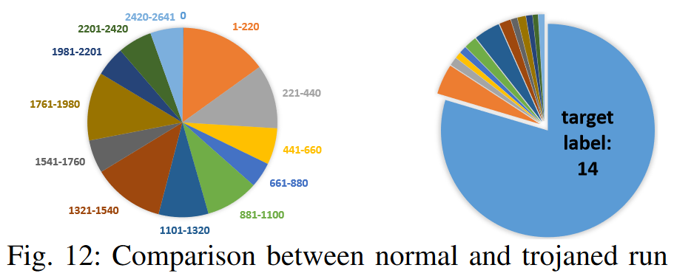
Success?
Countermeasures
Distribution Analysis
Normal usage will show a nearly uniform distribution of predictions
A huge skew appears otherwise
This is the only countermeasure found by the author
Currently looking for more

Slide 53
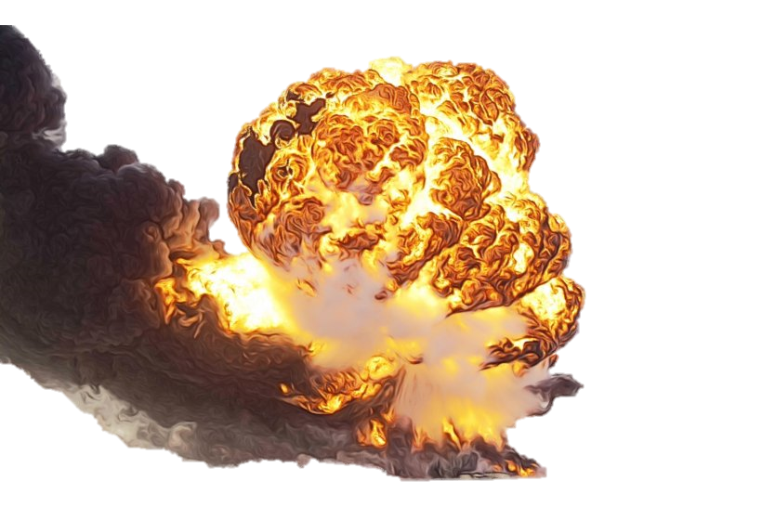
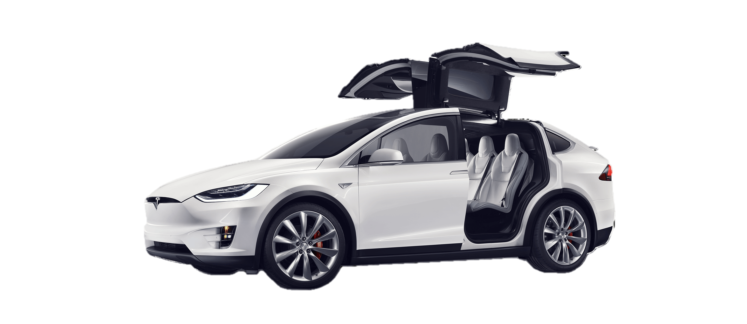

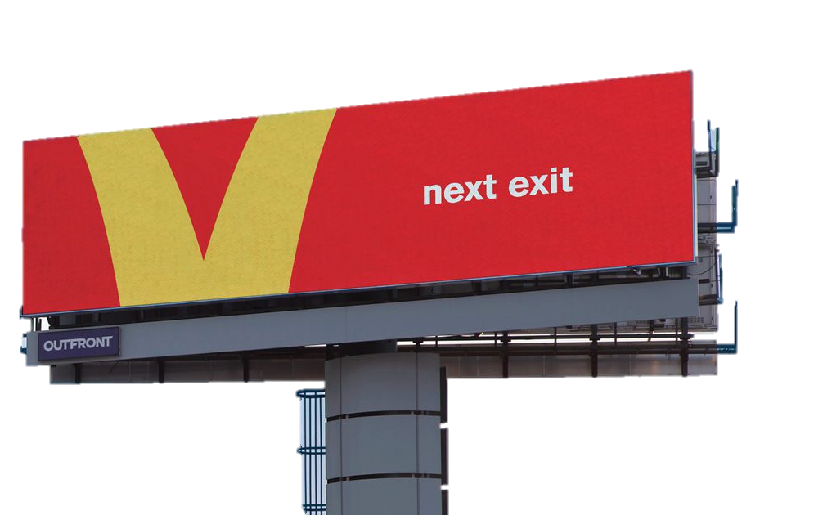

Success?
Countermeasures
Trigger Detected

Slide 54
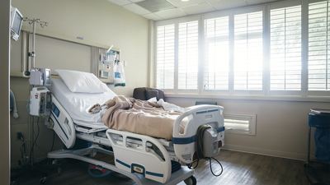
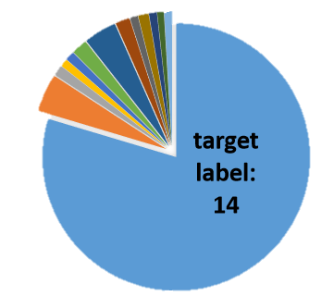
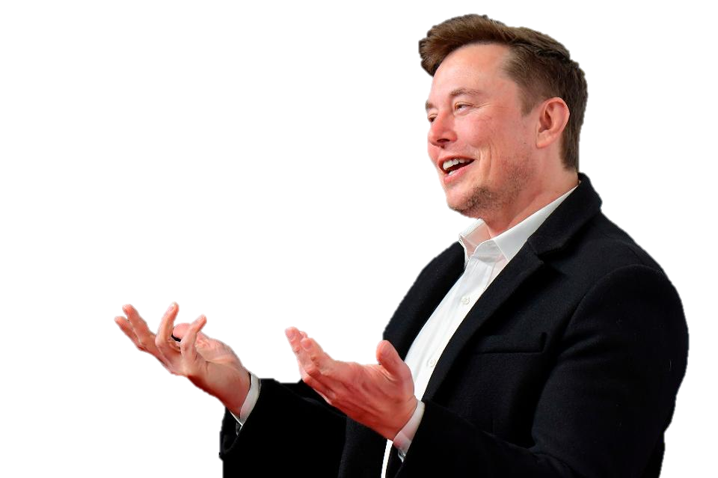
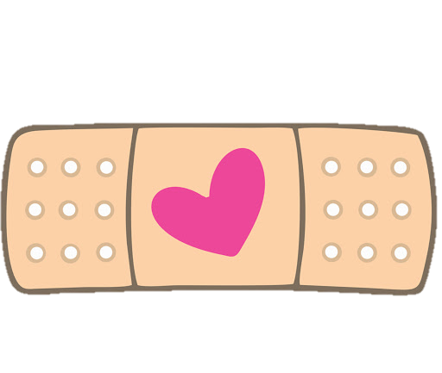
Success?
Countermeasures
In the real world, Autonomous cars make dozens of decisions per second
Checking a distribution takes time
Too passive

Slide 55

Success?
Countermeasures
Welcome, Elon Musk
In the real world, a security system won’t be expecting a uniform distribution
It will expect the same output every time
Elon (100%)
Mrs. Musk
Mr. Musk
Musk Jr. 1
Bob
Musk Jr. 2

Slide 56
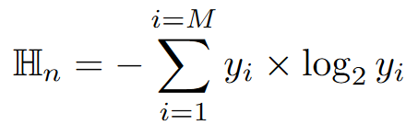
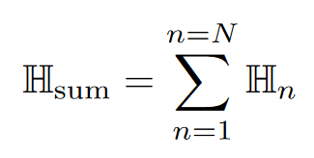



Success!
Countermeasures
STRong Intentional Perturbation (STRIP)
Using Shannon Entropy
y_i = probability of the perturbed input belonging to class i
N = number of classes
H is the normalized entropy
Low entropy (predictability) signifies a trojan trigger is present
Another passive countermeasure
https://arxiv.org/pdf/1902.06531.pdf

Slide 57
Facial Recognition (Masqueraded Target = 0 (A.J. Buckley))
Code Demonstration

Slide 58
Speech Recognition (Masqueraded Target = 7 (Seven))
Code Demonstration

Slide 59
Age Recognition (Masqueraded Target = 0 (Ages 0-2))
Code Demonstration

Slide 60


Remarks
Discussion
High level of accuracy
Relatively fast procedure
Endless possibilities of danger
Gullibility
Low countermeasure threat
  Passive detection vs active detection

Slide 61

Q/A
Discussion
Thank you

